Slide 1
Module 5:
Fairness
Creating fair and ethical ML models for cybersecurity
ML for Cybersecurity

Slide 2
FAIRNESS in the MEDIA

Slide 3
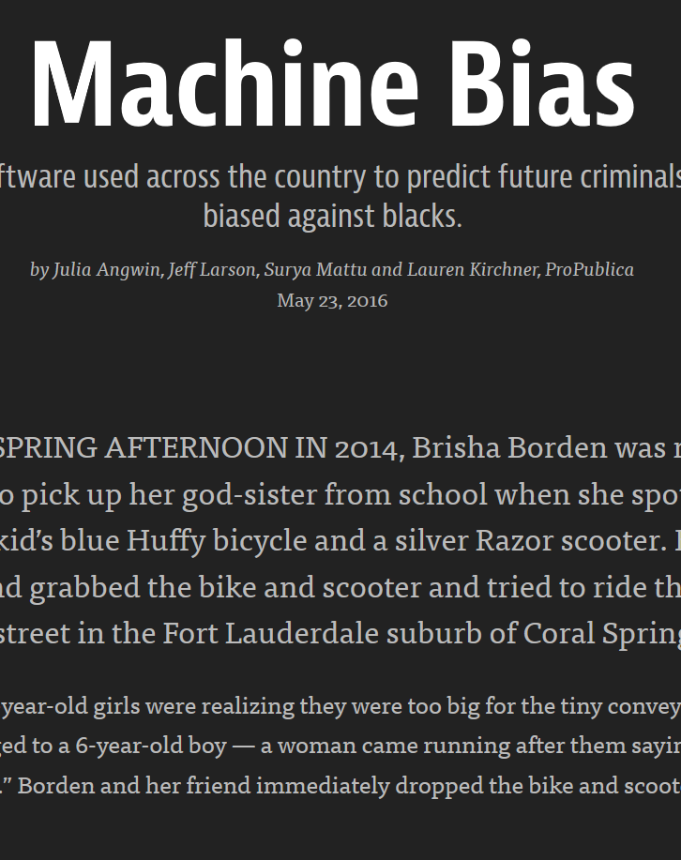
COMPAS System
Used for risk assessments (bail)
Based on answers to 137 questions
ProPublica obtained data:
Broward County, Florida
ProPublica: “It’s biased against blacks.”
Model author: It’s equally accurate across demographic groups!

Slide 4
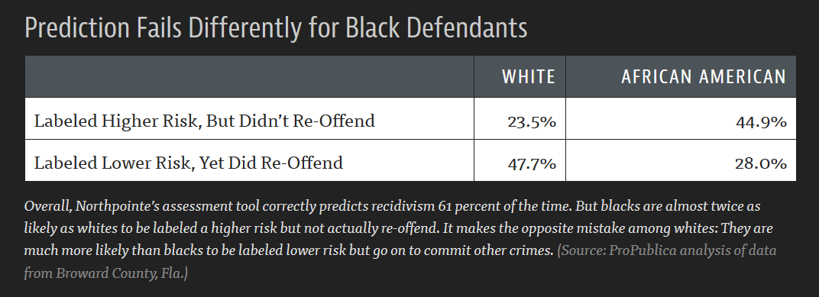
COMPAS System: Evidence of Discrimination?

Slide 5
Challenges for Cybersecurity ML
What if ML model for detecting fraudulent accounts is more likely to accidentally flag accounts of men as fraudulent?
Risks of accidentally locking a valid account include:
Unnecessary help desk calls
Customer abandonment
Stranding a customer or negatively impacting their opportunities
Negative stories in the press
What recourse does a customer have?

Slide 6
Difficulty Of Being Fair

Slide 7
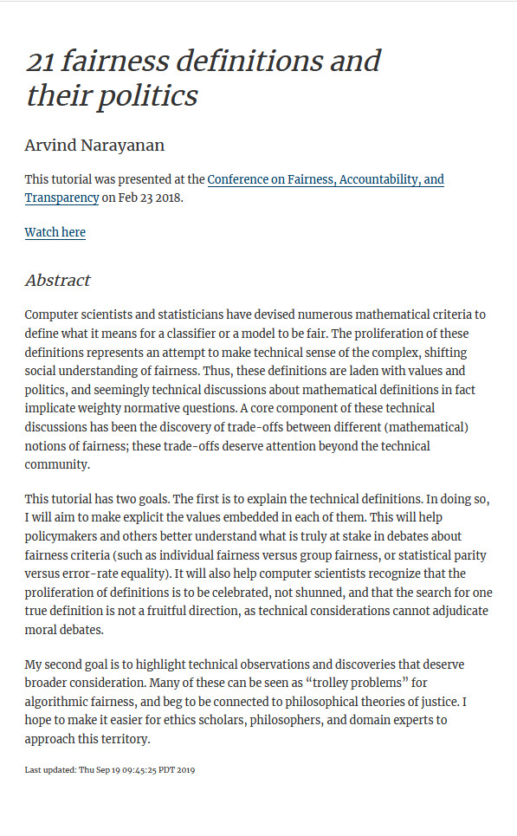
Defining Fairness
Dozens of potential definitions!
Terms conflated across disciplines
Political philosophy
Employment law
Computer science
See: Deirdre K. Mulligan, Joshua A. Kroll, Nitin Kohli, Richmond Y. Wong. This Thing Called Fairness: Disciplinary Confusion Realizing a Value in Technology. PACM HCI (CSCW), 2019.

Slide 8
Definition 1: Individual Fairness
“Similar people should be treated equally”
One of the early definitions of fairness
How do you define “similar”?
What if one class of “similar people” is treated poorly?

Slide 9
Definition 2: Group Fairness
Statistical non-discrimination
Basis in employment and housing law (e.g., Fair Housing Act)
Primarily considers protected classes
Race, gender, sex, national origin, religion, marital status, etc.
Goal: approximately equalize some quantities across demographic groups
Focus on disparate impact (treating different groups differently)

Slide 10
Definition 2: Group Fairness (Example Metrics)
Demographic parity (equal outcomes)
Equalize the chance of positive classifications across groups
Equalized accuracy across groups
Equalized odds (true positive rate and false positive rate are equal)
… many more!

Slide 11
Definition 3: Process Fairness
Exclude from the model predictor variables that are deemed to be unfair for the classification task
Important question: Who gets to decide what is fair? Is it majoritarian voting? Should it be experts in law/technology?
Beware of proxy variables (other variables correlated with variables you intend to exclude)

Slide 12
Tools

Slide 13
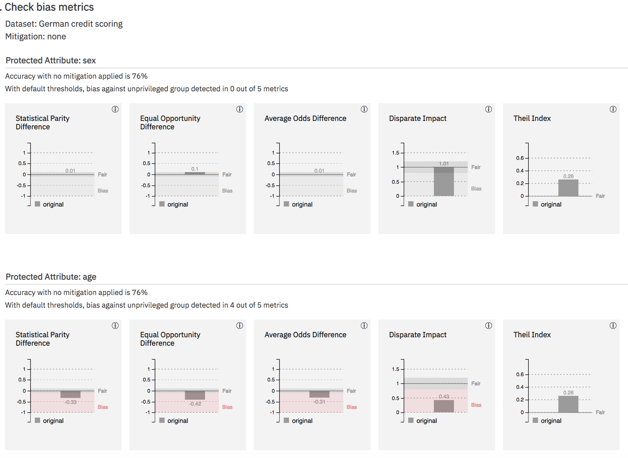
IBM AI Fairness 360

Slide 14
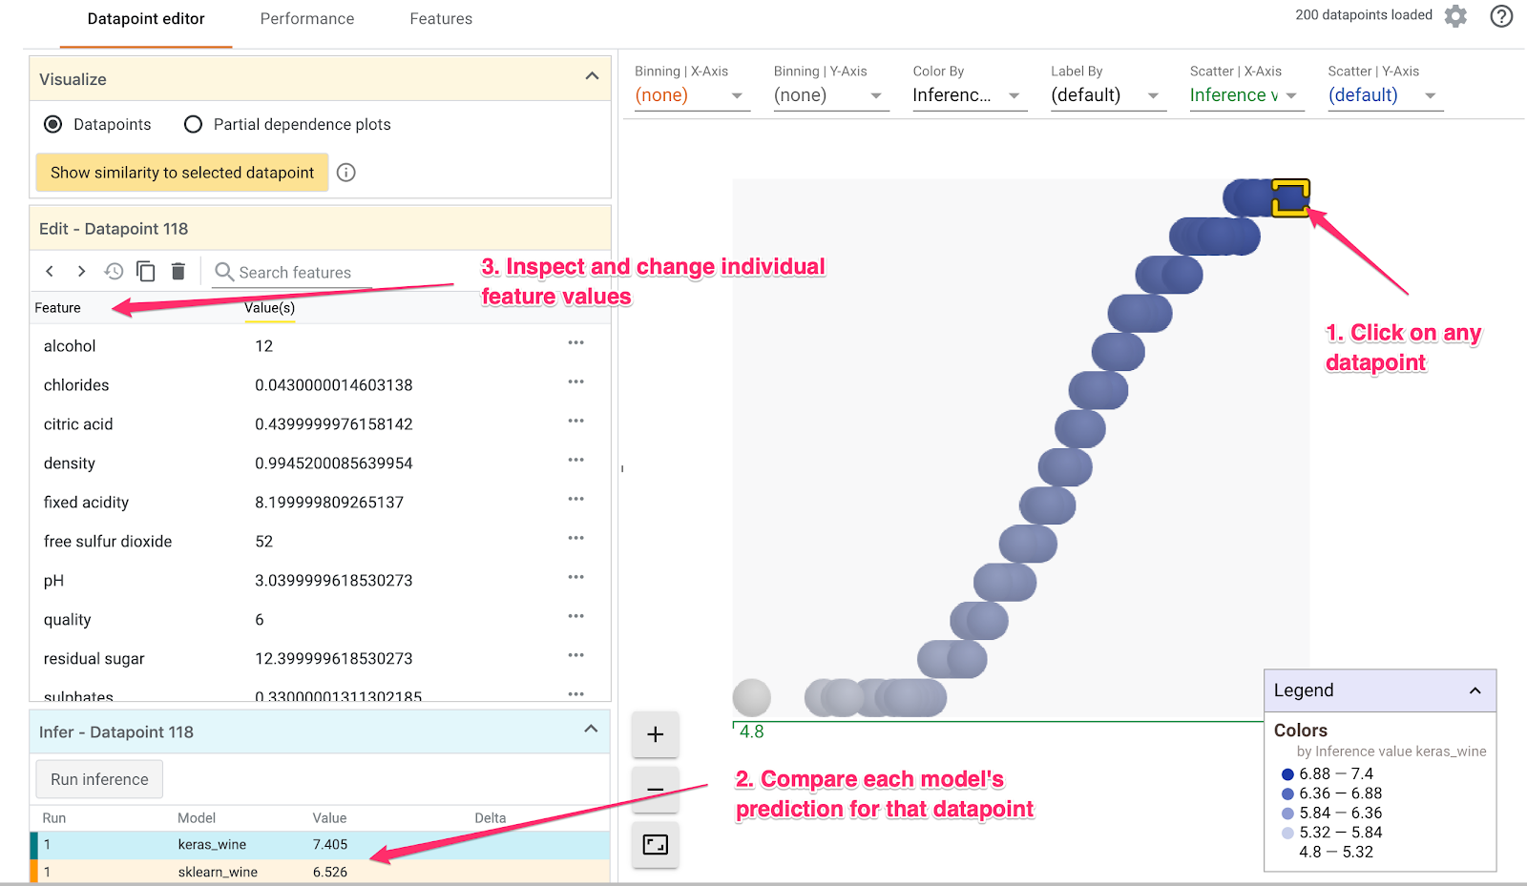
Google What-If Tool

Slide 15
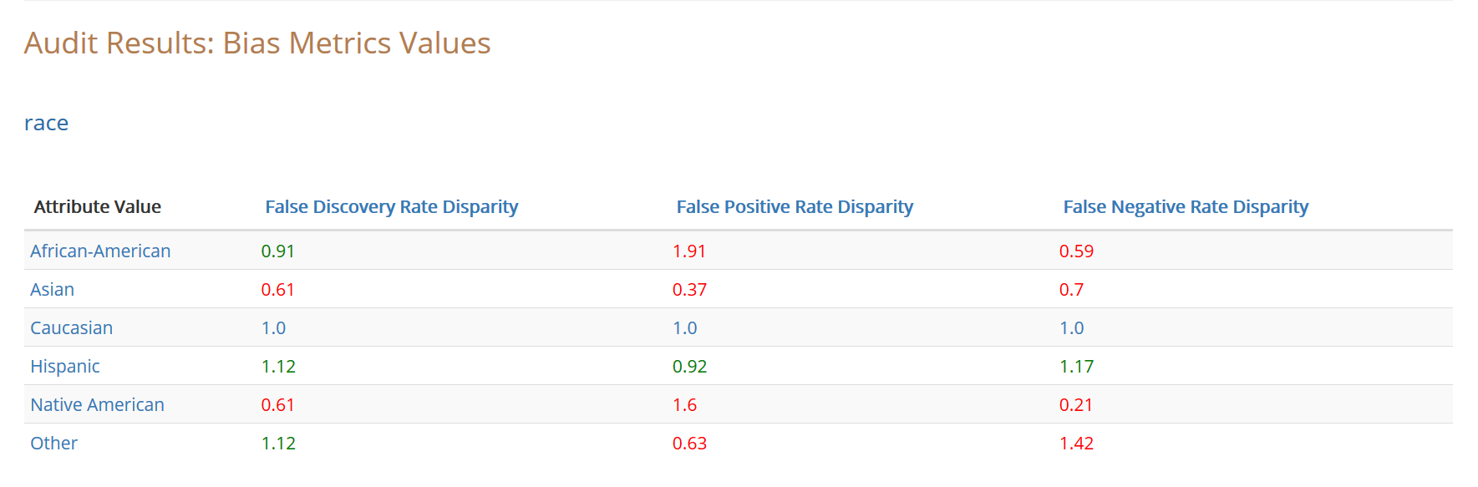
UChicago Aequitas Tool

